Slide 1
getsetgo agent
CAPSTONE PROJECT
Presented By: Yashvi Srivastava
College Name & Department : Rajkiya Engineering College Kannauj & Electronics Engineering

Slide 2
OUTLINE
Problem Statement
Technology used
Wow factor
End users
Result
Conclusion
Future scope
IBM Certifications
Git-hub Link

Slide 3
Problem Statement
Planning personalized travel experiences can be overwhelming due to scattered information across multiple platforms, varying preferences, time constraints, and budget limitations. Travelers often struggle to discover suitable destinations, activities, or accommodations efficiently.
Proposed Solution: The project proposes a streamlined solution to integrate IBM's watsonx.ai capabilities with LangGraph agents for enhanced AI-driven interactions. It demonstrates how to authenticate using IBM Cloud API keys, configure an agent with tools, and utilize powerful foundation models for chat-based inferencing.

Slide 4
Technology used
Granite 3-3-8B Instruction Model – IBM's state-of-the-art large language model optimized for instruction-following tasks, used to generate intelligent and context-aware responses within agent workflows.
IBM Cloud Lite – Provides a secure, scalable environment for deploying AI agents, managing API access, and integrating services.
Natural Language Processing (NLP):Facilitates user input understanding, intent recognition, and natural conversational flow to drive AI decision-making.
LangGraph:Structures the agent’s behavior as a directed graph, enabling dynamic, task-oriented interactions and flexible workflow management.

Slide 5
IBM cloud services used
IBM watsonx.ai: Core platform for building and deploying foundation model-powered agents.
Watsonx.ai Studio:Low-code environment to build, manage, and configure agent workflows.
Watsonx.ai Runtime:Executes real-time queries and connects user inputs with models and tools.
IBM Cloud Identity & Access Management (IAM): Secures access using personal API keys.
watsonx.ai Prompt Lab & Agent Lab: Tools to prototype, save, and manage agent workflows and prompts.
IBM Cloud API Gateway (via SDK): Facilitates secure communication between agents and watsonx services.

Slide 6
Wow factors
Agentic Intelligence – Uses LangGraph to enable dynamic, task-driven workflows that adapt to user needs in real time.
Instruction-Tuned LLM (Granite 3-3-8B) – Delivers highly relevant, personalized responses with natural language understanding.
Seamless Cloud Integration – Built on IBM Cloud with secure, scalable deployment of AI services and APIs.
Low-Code Development – Watsonx.ai Studio allows quick agent creation and modification without deep programming knowledge.
Real-Time Execution – Watsonx.ai Runtime ensures smooth, responsive interactions between users, tools, and models.

Slide 7
End users
AI/ML Developers – Build, customize, and deploy intelligent agent workflows using foundation models.
Data Scientists – Leverage the agentic framework to automate data exploration and insights generation.
Enterprises & IT Teams – Integrate agent-based systems into business workflows for smarter automation.
Researchers & Educators – Use the platform for experimentation, teaching, and advancing AI understanding.
Product Managers – Prototype AI-driven features quickly without deep technical overhead using low-code tools.

Slide 8
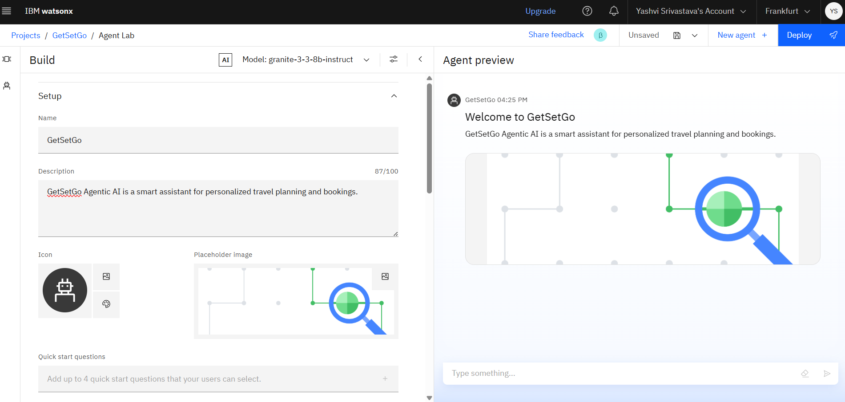
Results

Slide 9
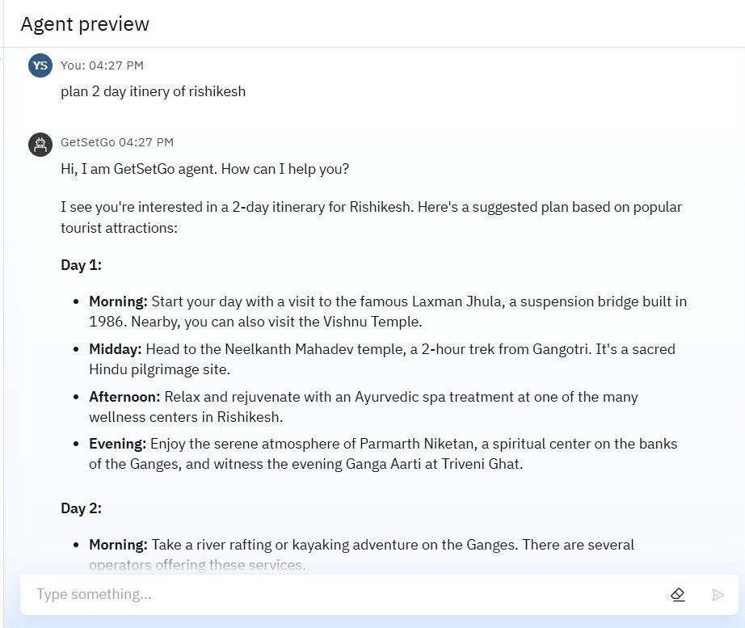
Results

Slide 10
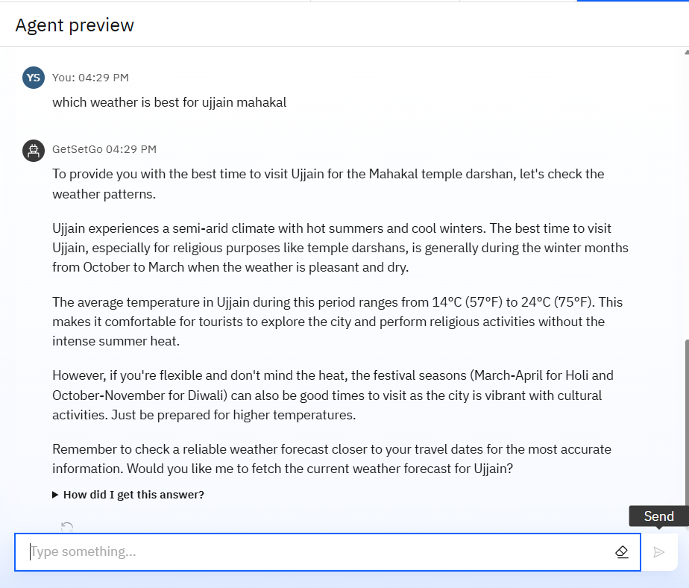
Results

Slide 11
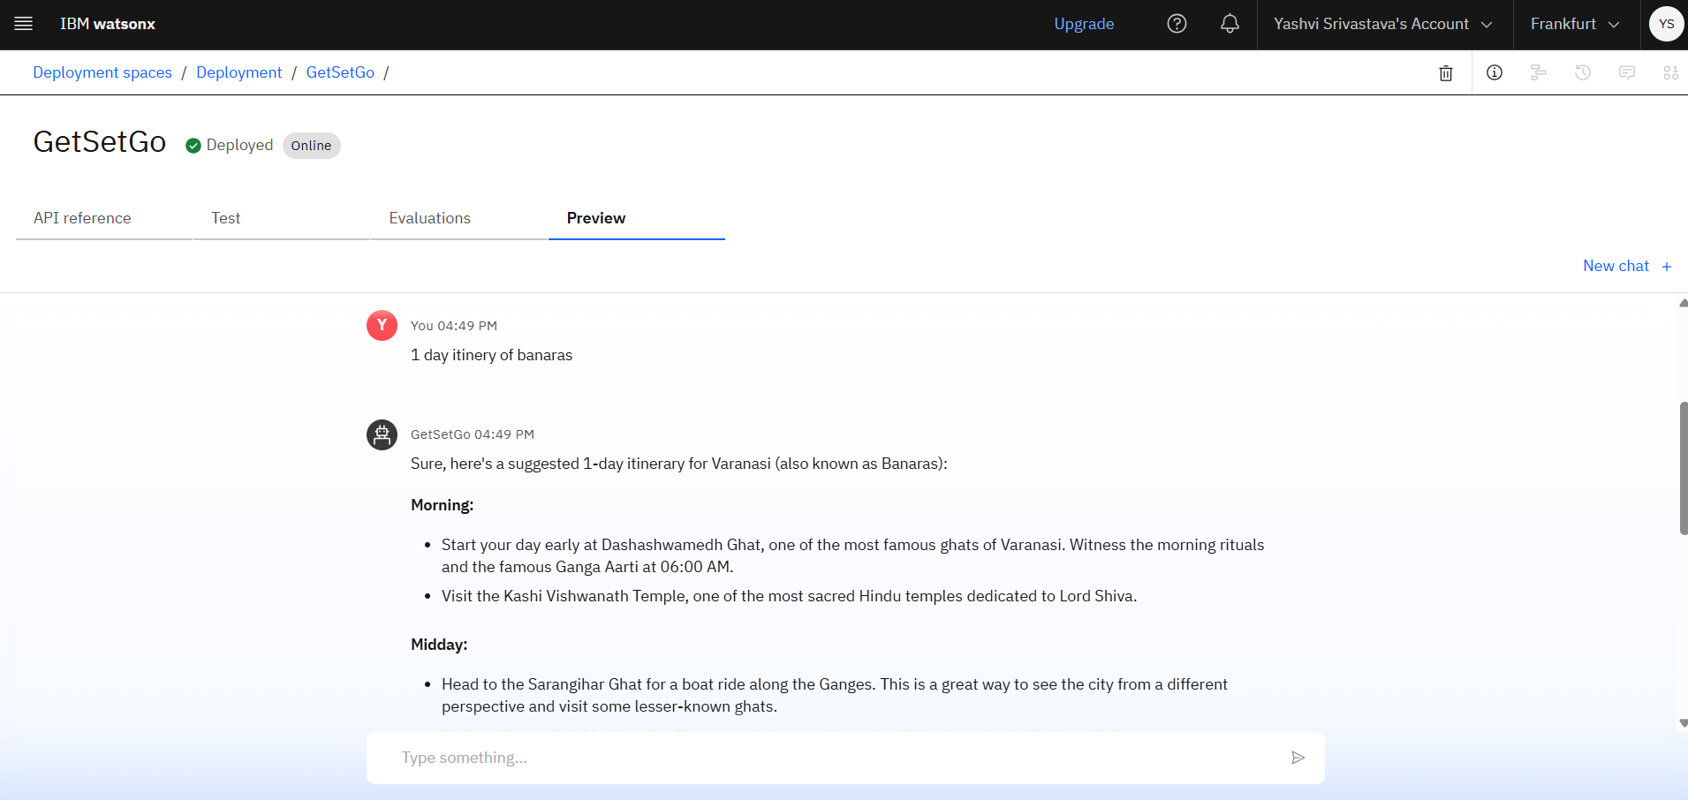
Results
Deployed AI Agent

Slide 12
Conclusion
Generated personalized travel itineraries based on user preferences and input.
Suggested destinations, activities, and accommodations dynamically.
Handled real-time travel-related queries with intelligent, context-aware responses.
Automated planning tasks like budget estimation, destination research, and activity selection.
Delivered a smarter, faster, and stress-free trip planning experience with high personalization and convenience.

Slide 13
Future scope
Multilingual Travel Planning – Support for itinerary creation and query handling in multiple languages.
Voice-Activated Agent – Enable hands-free travel planning through voice commands.
Real-Time Collaboration – Allow multiple users (e.g., friends or family) to co-plan trips interactively.
Personalized Deal Integration – Fetch real-time deals on flights, hotels, and activities based on preferences.
Seamless Booking Integration – Connect directly with travel booking platforms for instant reservations.
AI-Assisted Travel Journaling – Automatically draft travel summaries, blogs, or reports based on user itineraries.

Slide 14
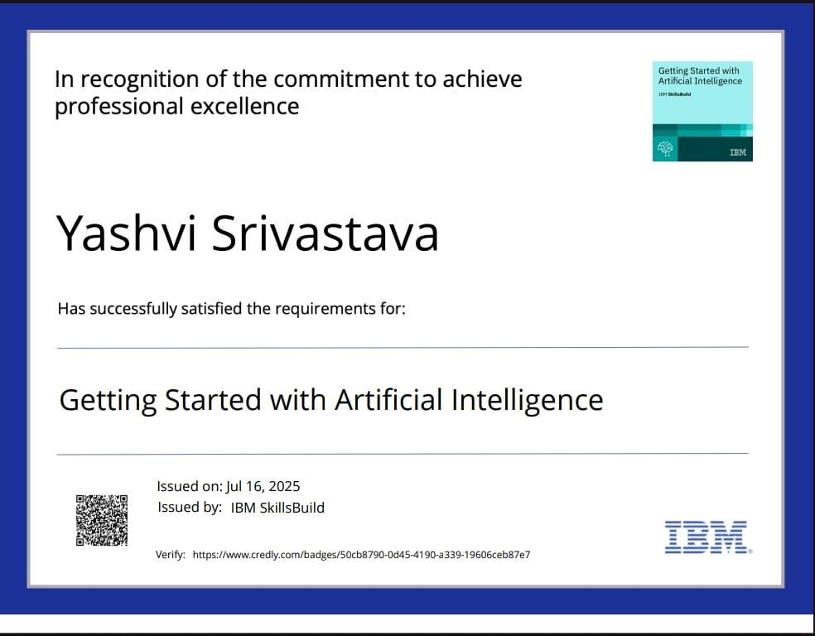
IBM Certifications

Slide 15
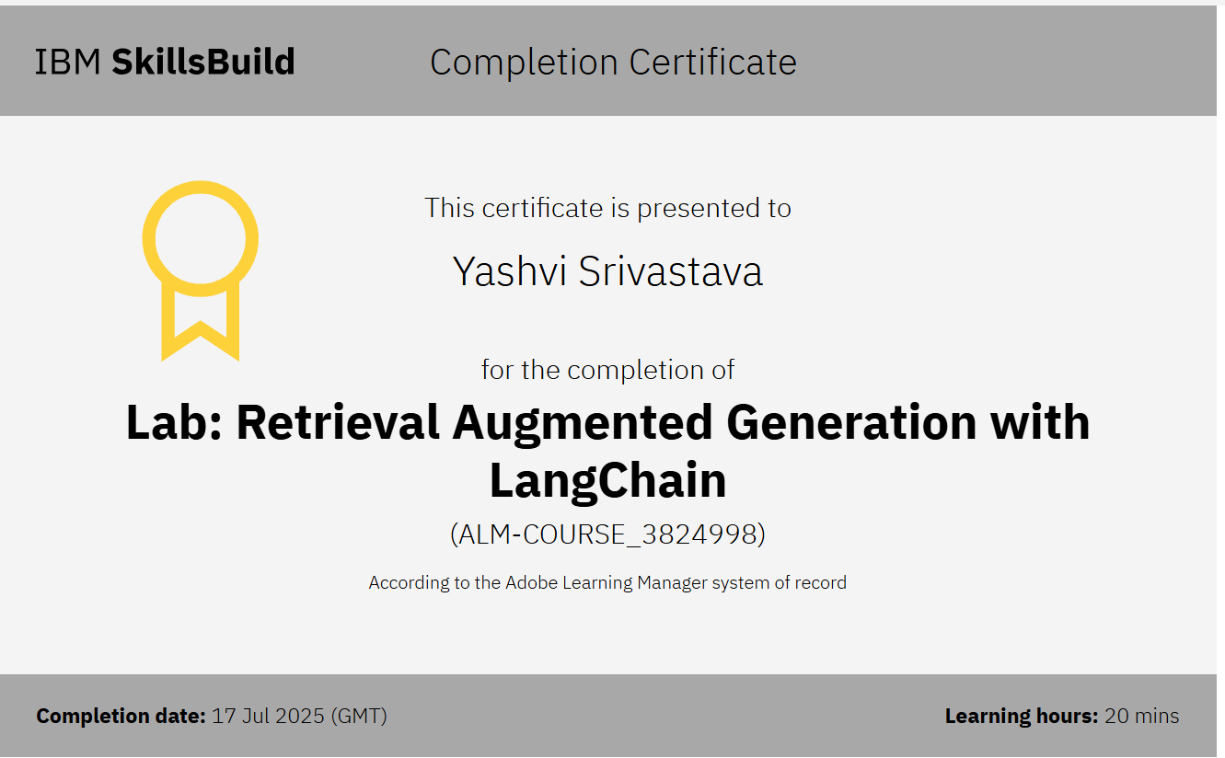

Slide 16
GitHub Link
https://github.com/yashvisrivastava25/GetSetGo-Agentic-AI

Slide 17
THANK YOU

